Slide 1
Amica Final Presentation
Eric Zhang, Kathryn Doorley, Wilson Dong, Matthew Houde, and Edmilson Da Moura
Notes:
Kathryn

Slide 2
Learning Agenda
Notes:
kathryn

Slide 3
Objective
Understand what customers are saying about each Primary Reason category.
Determine if there are any topics that are not currently identified as Primary Reasons, but occur frequently in customer comments.
Ascertain if there are any business insights or key takeaways that could benefit the company and make recommendations for improvement to Amica
Notes:
Edii

Slide 4
Hypotheses and General Approaches
Respondents who have a more positive sentiment in their comments will use customer service as their primary reason
There are other frequent reasons for choosing their NPS score, but we need to determine them through the comments
Many negative comments for Amica customer service are from unclear/inefficient phone-call communications.
Amica websites and apps are not as welcomed compared to the in-person service.
The cases of error policy renewals have increased within three years.
Create an unsupervised learning model to cluster respondents into NPS groups and Primary Reasons
Extract n-grams from comments to see what are the most common “other reasons”
Filter for comments relating to phone operations and gain an understanding to what trends exist in those specific comments
Understanding negative sentiments to better understand how it can be positive for the customer experience
Improve the sentiment accuracy for sentences with double-negative structure/ passive ironic tones
Notes:
Kathryn

Slide 5
Milestones
• Finalize Learning Agenda
• Exploratory Data Analysis on All Datasets
• Feature Engineering (N-grams, Sentiment)
• Sentiment Analysis for All Comments and Other Category
• N-Grams Visualizations
• Data Preparation and Cleaning (Remove nulls, stop words, etc.)
• Model Selection and Training for Clustering of Primary Reasons
• Model Testing and Deployment
• Analysis Presentation and Submission
Notes:
Edii

Slide 6
Data Cleaning
Handle contractions, make lowercase, remove stopwords, remove punctuation
Feature Engineering-
# of Words
# of Numbers
Sentiment Analysis
Vectorization/Tokenization of Data
Unsupervised ML/Clustering
Notes:
Edii

Slide 7
CTS Data
Notes:
Matt

Slide 8
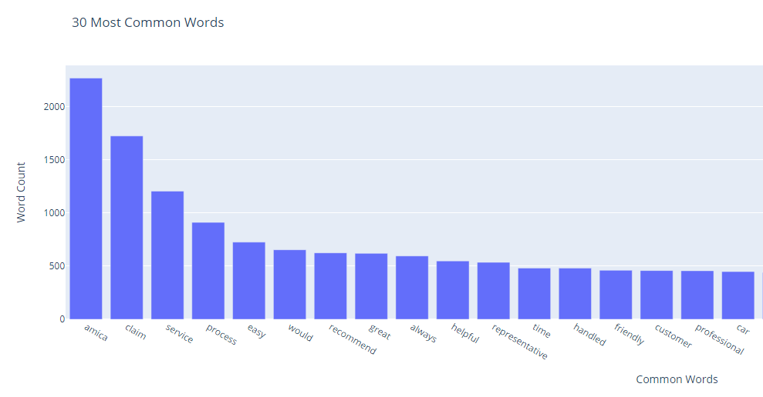
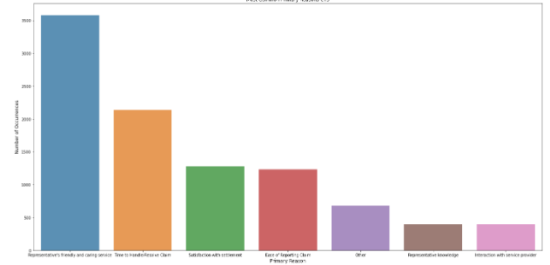
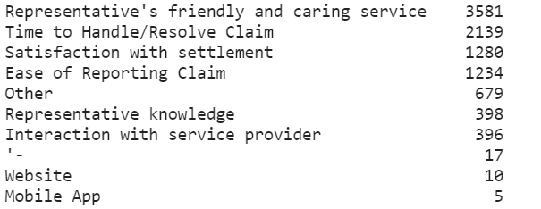
Common Words and Categories
Notes:
Matt

Slide 9
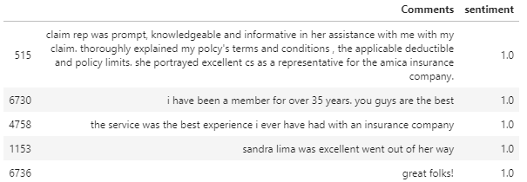
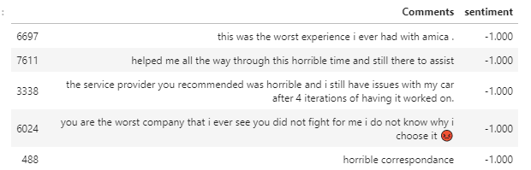
Best Comments
Worst Comments
Notes:
Matt

Slide 10
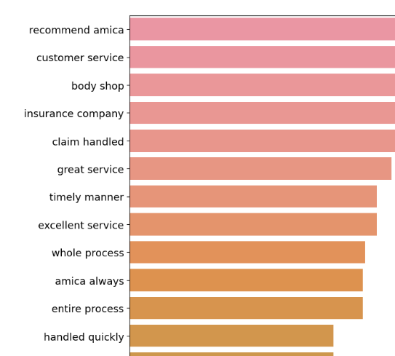
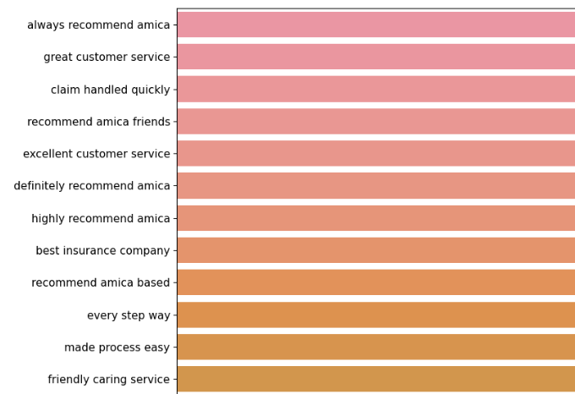
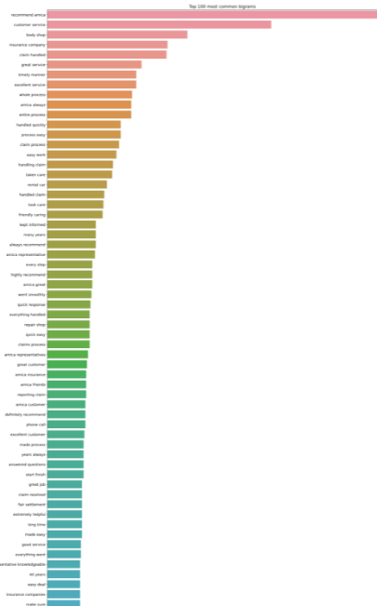
N- Grams
Notes:
Matt

Slide 11
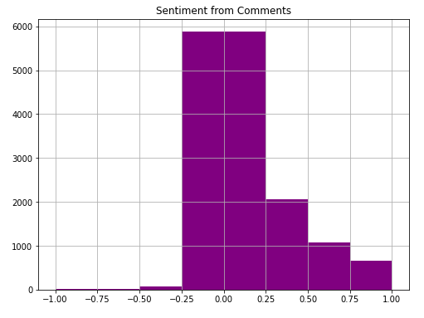
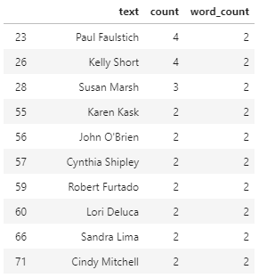
Additional Graphs
Notes:
Matt

Slide 12
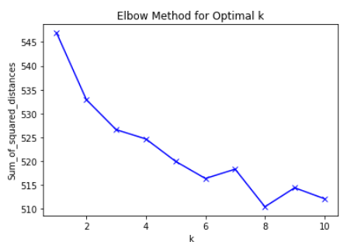
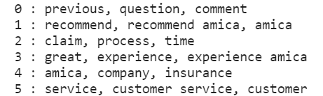
K Means Clustering
Vectorization of Data
Elbow Method
6 Clusters
Notes:
Matt

Slide 13
SCS Data

Slide 14
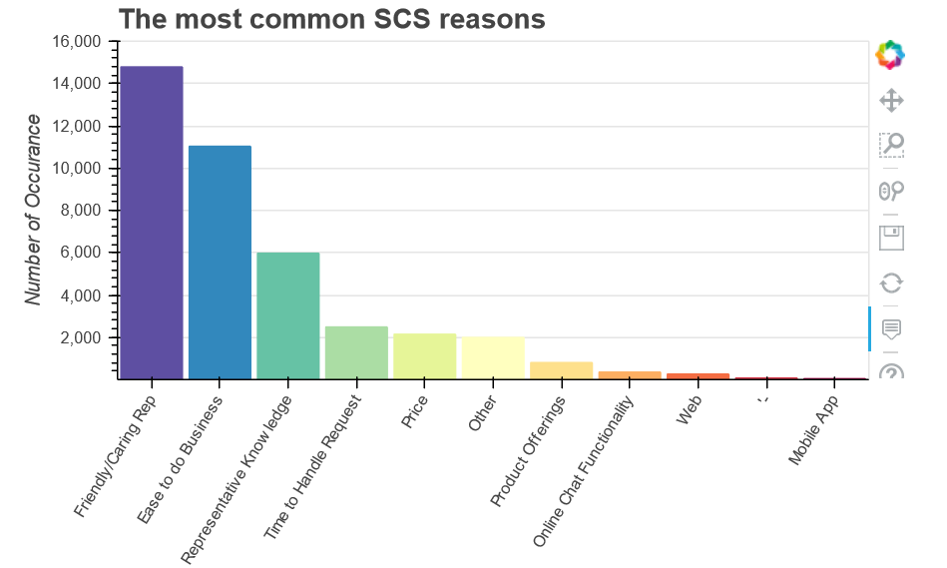
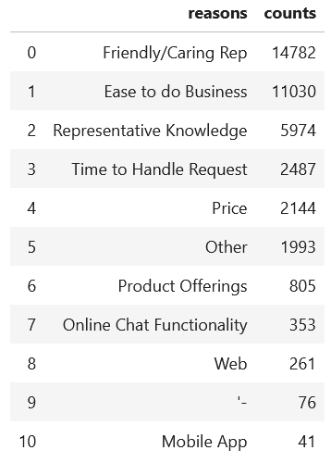
Top 10 SCS Primary Reason Frequency

Slide 15
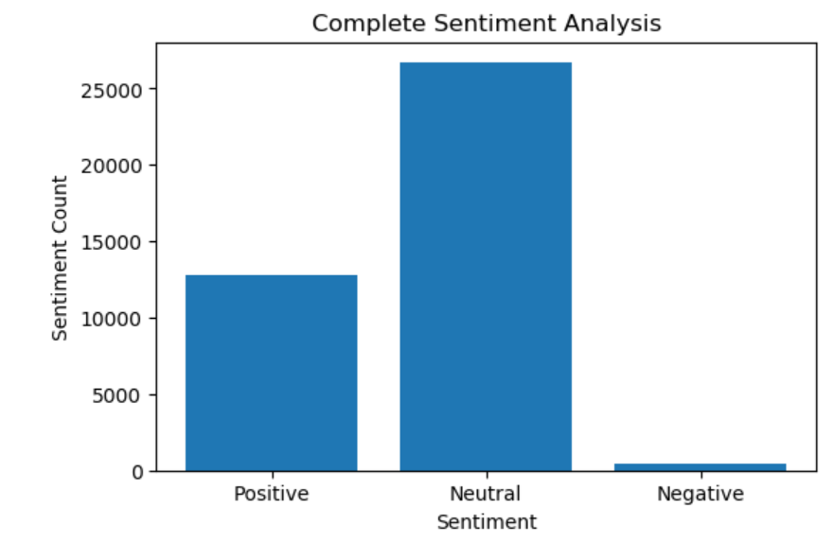
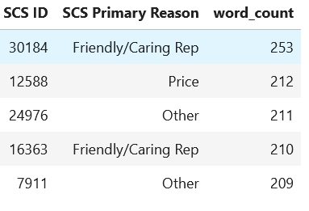
Sentiment Check & Comments Word Count

Slide 16
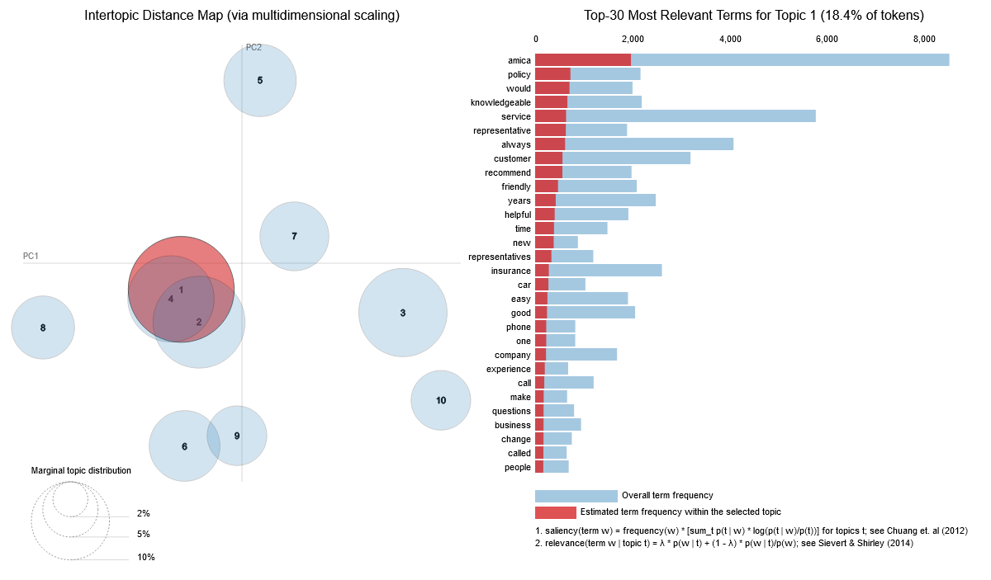
SCS Data LDA Topic Modeling
SCS Data General
LDA Topic Modeling

Slide 17
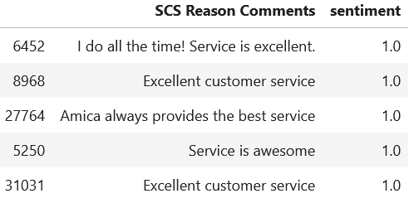
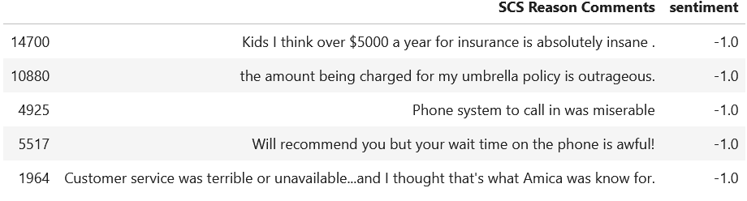
Positive Comments
Negative Comments

Slide 18
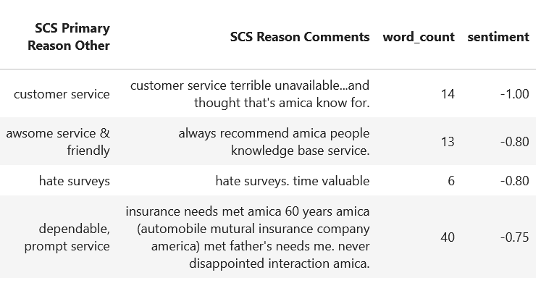
Other “Reasons” Exploration
Most Frequent Words in:
SCS Primary Reason Other
SCS Reason Comments

Slide 19
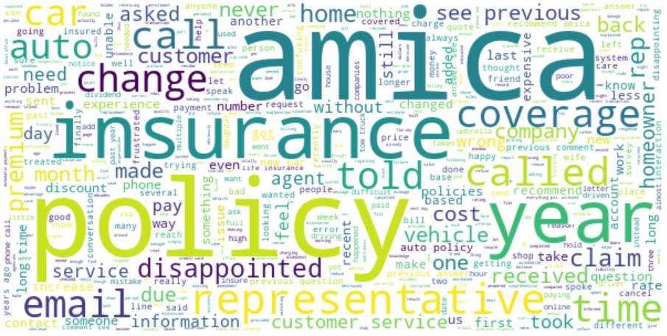
Word Cloud

Slide 20
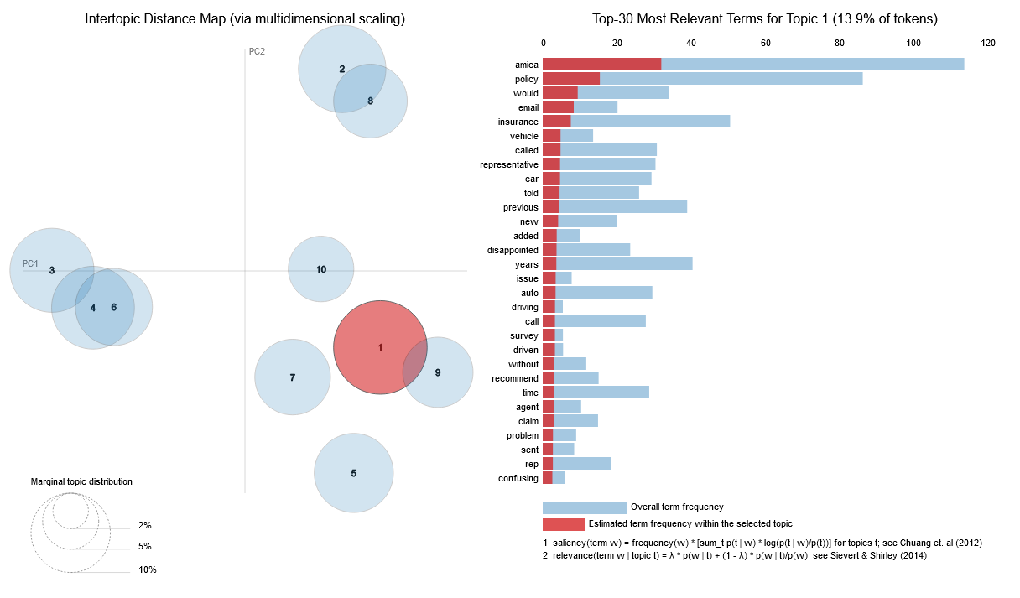
Negative Comment
LDA Topic Modeling
Notes:
LDA Topic Modeling

Slide 21
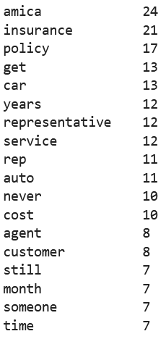
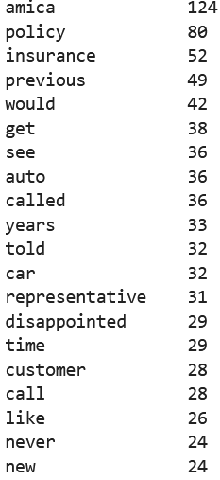
Top Frequently used Words in Negative Survey
SCS Primary Reason Other:
SCS Reason Comments:

Slide 22

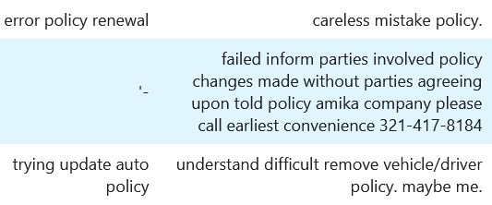
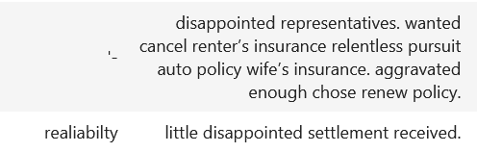
Searches Based on Keywords
Disappointed:
Policy:

Slide 23
REL Data

Slide 24
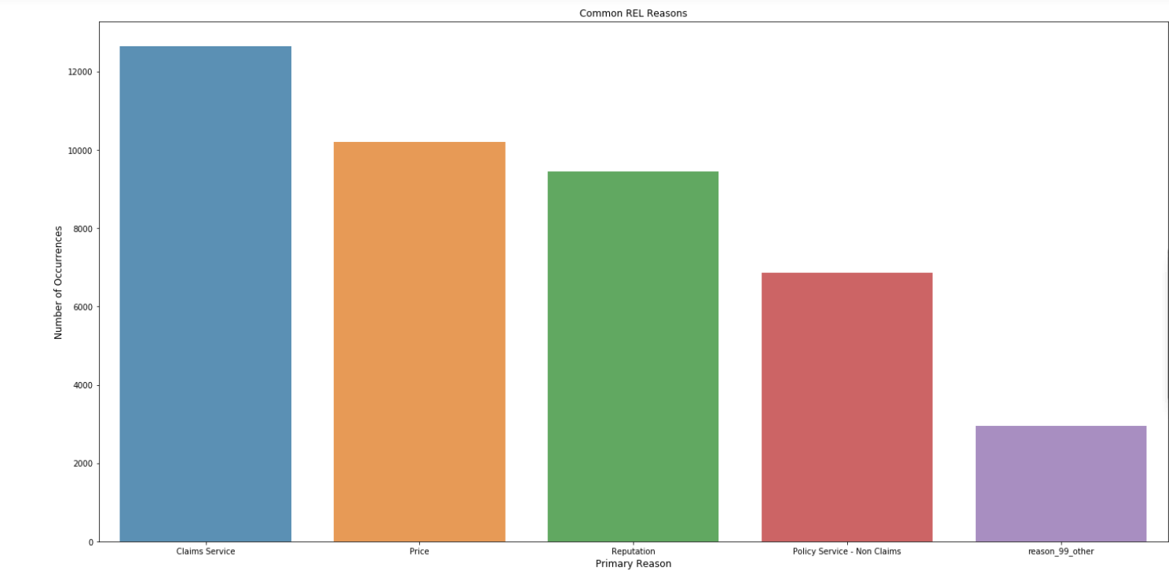
Common Reasons in REL
Notes:
Eric

Slide 25
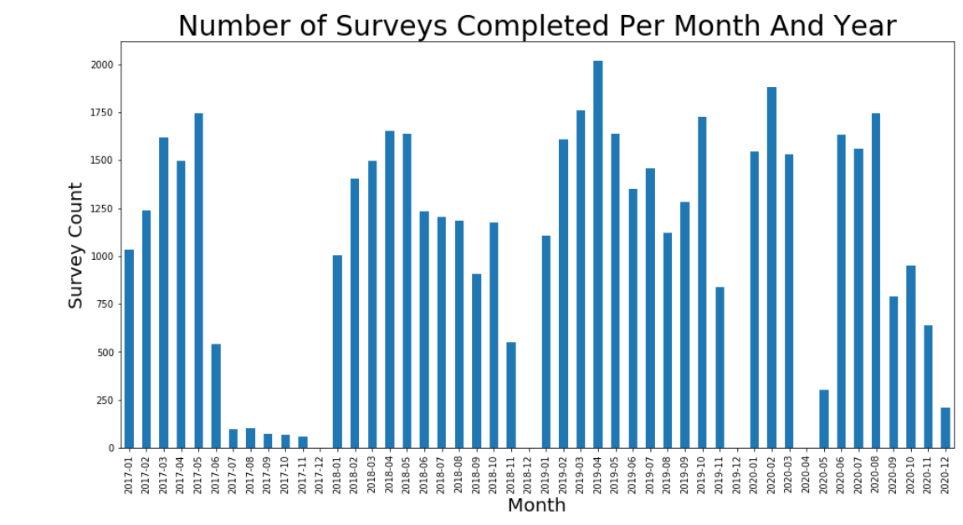
Survey Respondents by Month and Year
Notes:
Eric

Slide 26
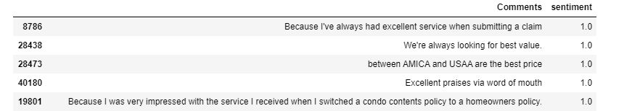
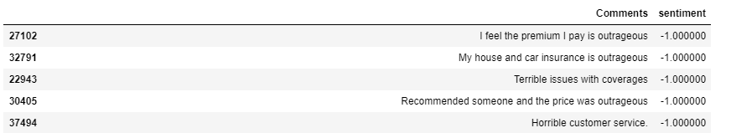
Best Comments
Worst Comments
Notes:
Eric

Slide 27
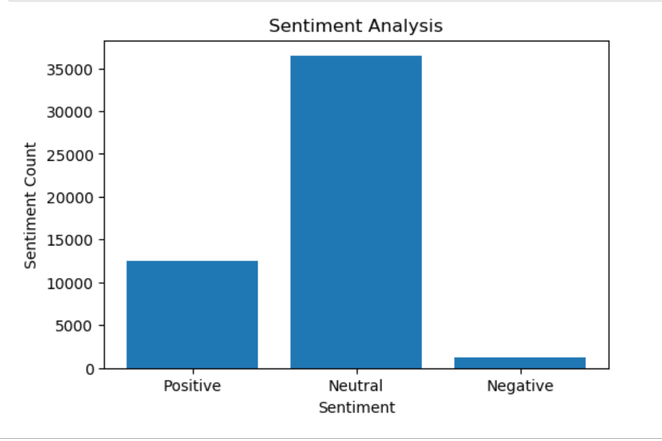
Sentiment Analysis
Notes:
Eric

Slide 28
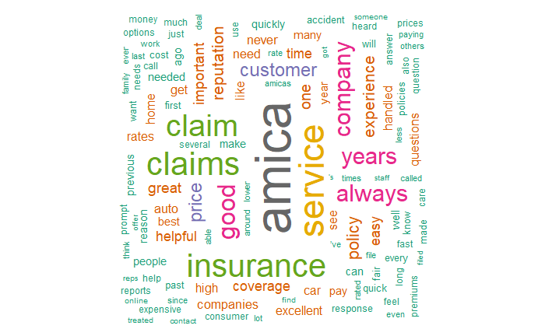
Word Cloud
Notes:
Eric

Slide 29
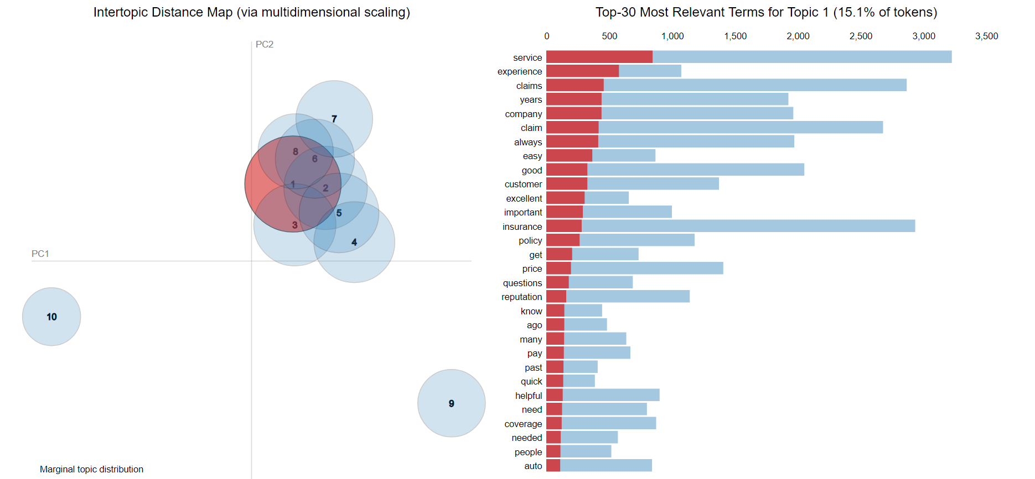
LDA Model- Largest Topic
Notes:
kathryn

Slide 30
Recommendations
Notes:
Edii

Slide 31
REL
SCS
CTS
Notes:
Edii

Slide 32
Customer Service
Average/Poor customer service
Customer Service
Improve phone system
Enhance customer service interactions
Provide more feedback/help
Price
Outrageous prices
Price
Provide a wider range of prices
More discounts/options
Economic pricing
Policy
Premium
Complaints about premium increases
Policy
Premium
More premium options
Optimize product range
Notes:
Edii

Slide 33
Primary Reasons Recommendations
CTS - Inconclusive evidence that there should be another category added to Primary Reasons, Website and Mobile App already low response rate
SCS - Remove the last few options, and create a reason ‘Online Experience’
REL - Splitting up Claims Service Reason, going further in-depth.
Notes:
kathryn

Slide 34
Conclusion
Notes:
Matt

Slide 35
What We Learned
Natural Language Processing
Text Analysis - N-grams, Topic Modeling, Stop Words, Data Cleaning Process, Sentiment Analysis
Modeling - LDA, CLustering, Vectorization, Embeddings
Communicating Data in Business Terms
Notes:
Matt

Slide 36
Thank You, Any Questions?
Notes:
Matt

